Slide 1

Project 2
Grayson MacKenzie, Carter McCardwell, Nick Merlino, Keith Miller, Nick Genovese

Slide 2
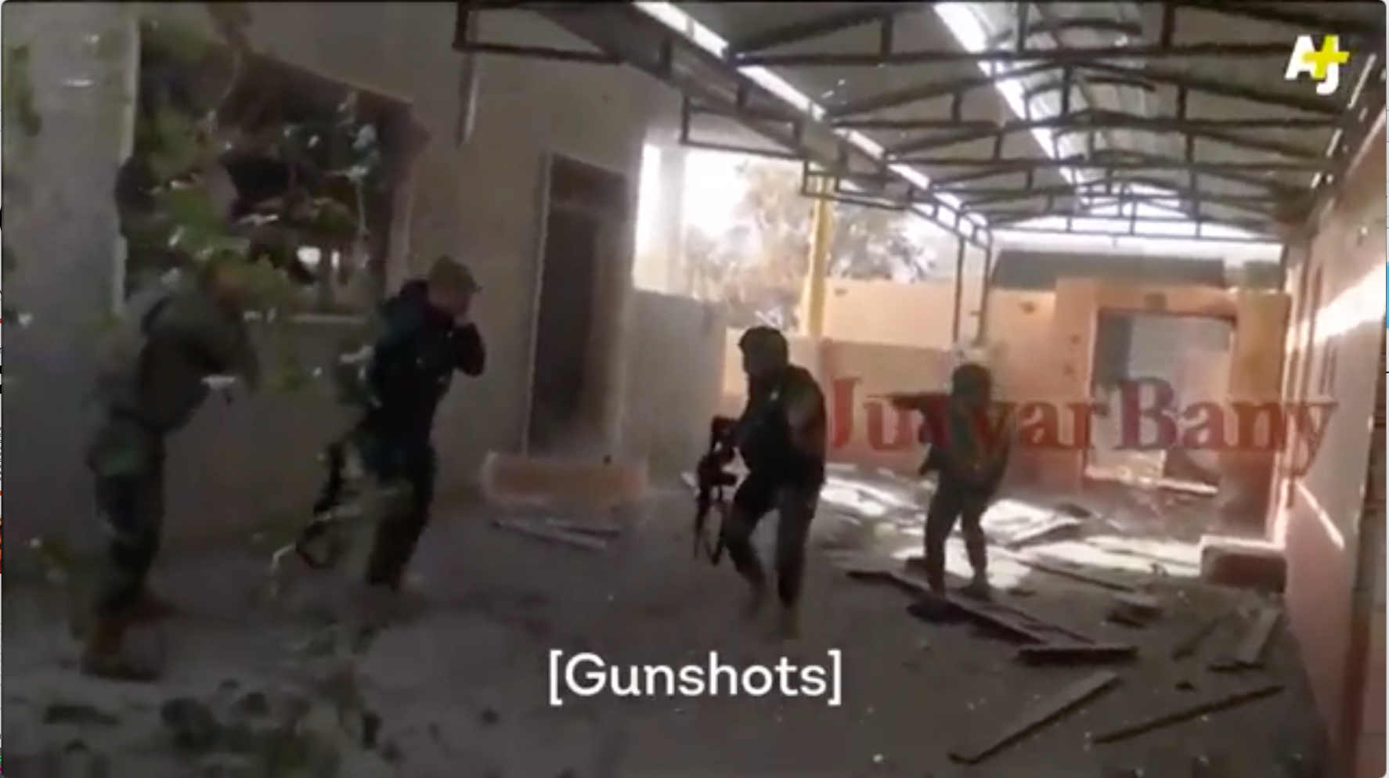
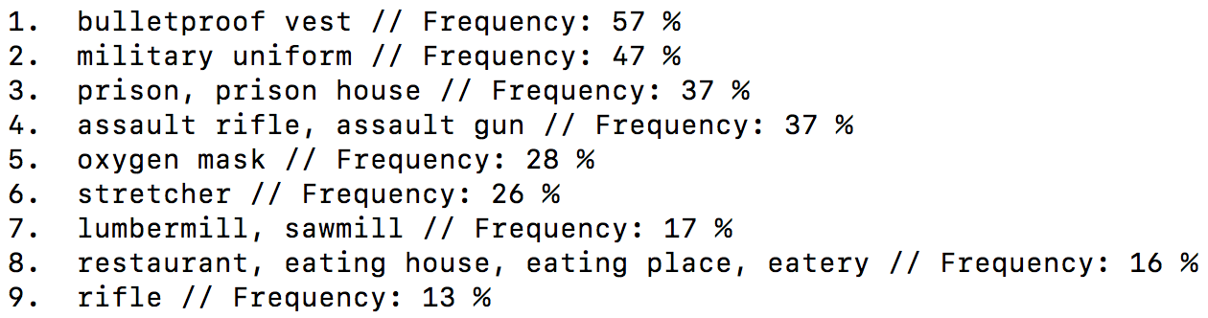
Contextual Recognition

Slide 3
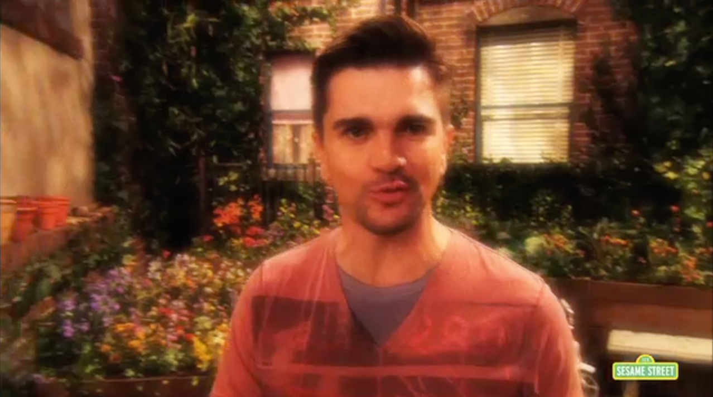
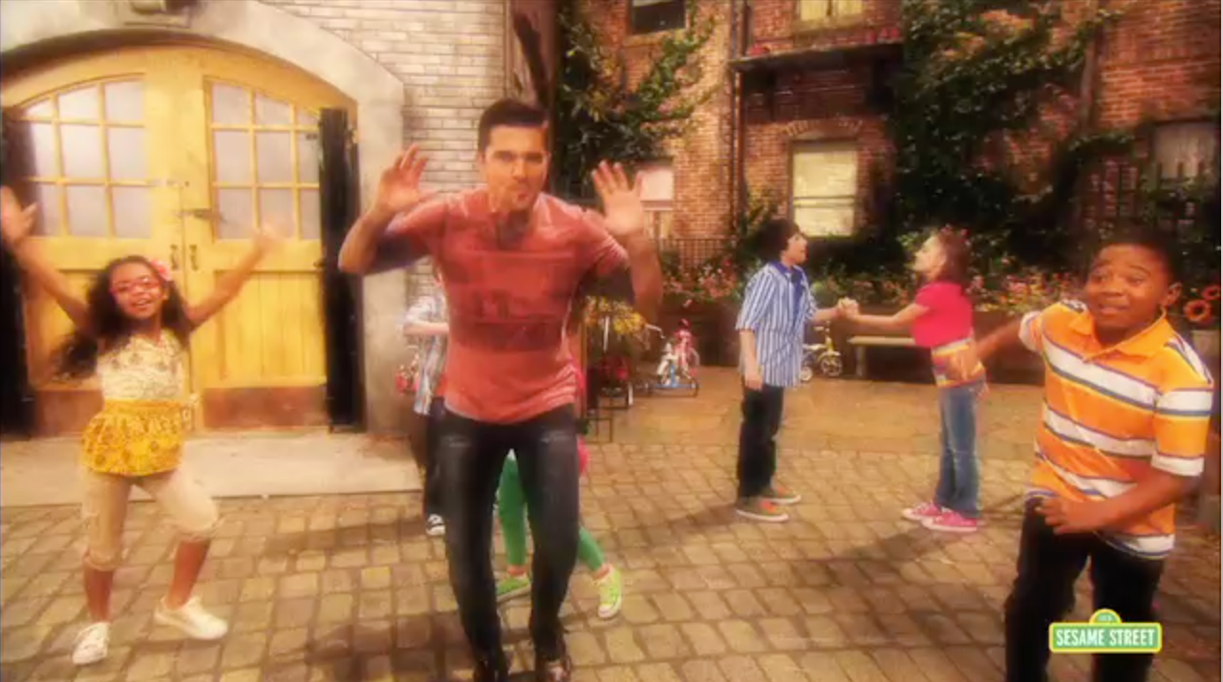
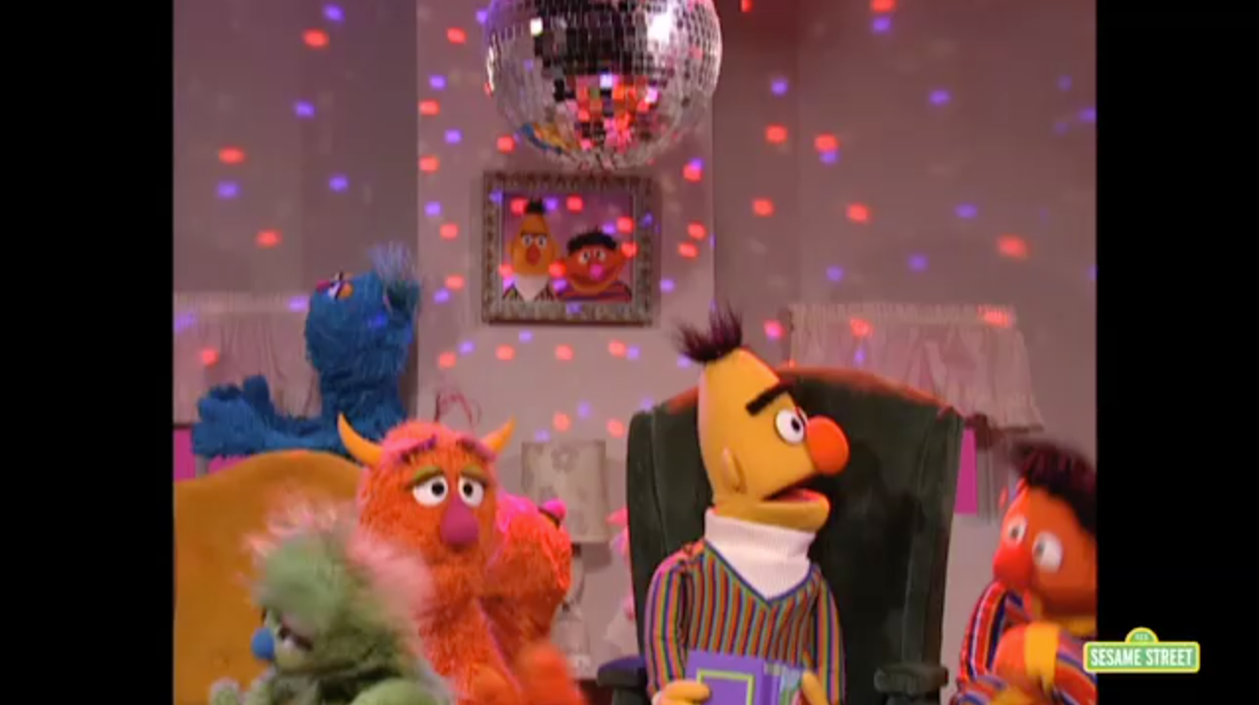
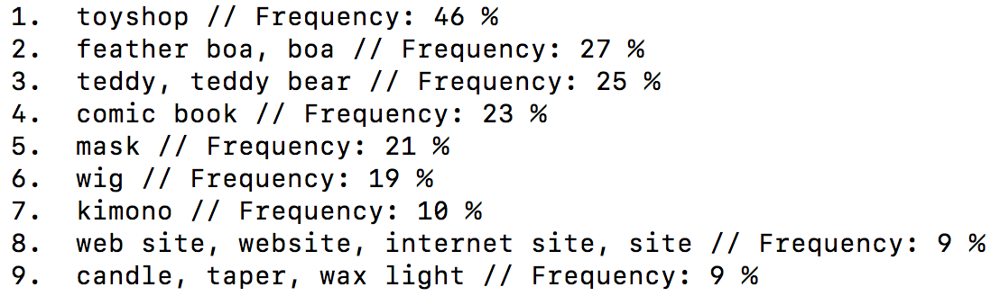

Slide 4
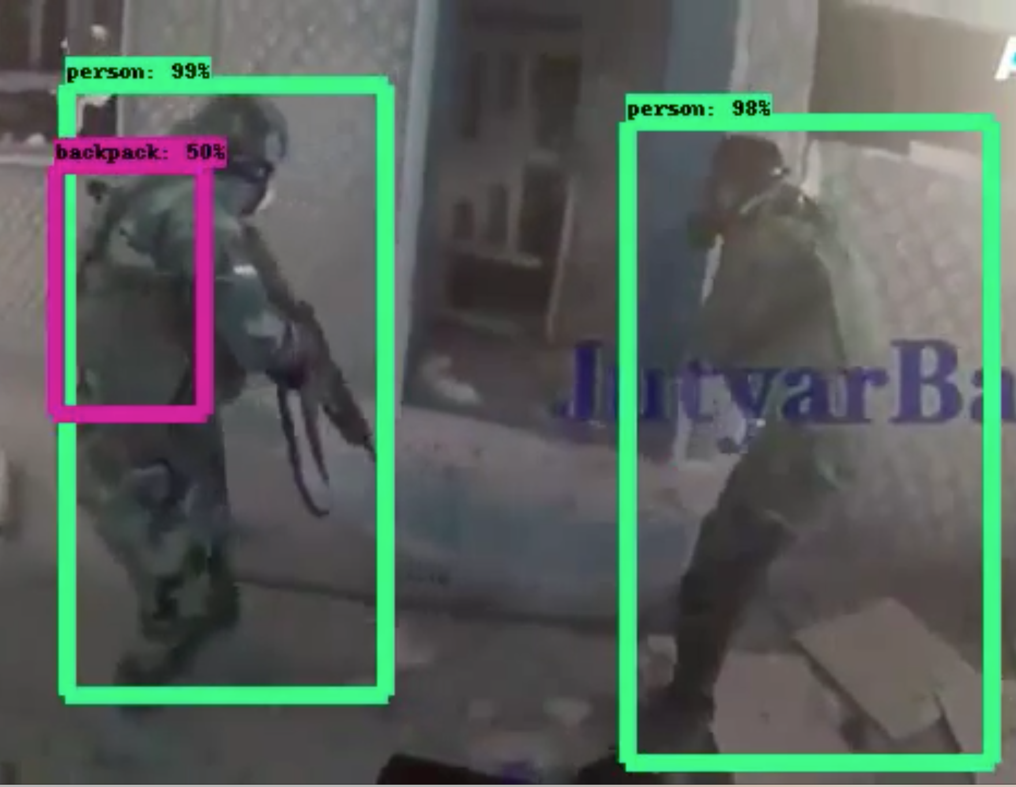
Embedded Object Recognition

Slide 5
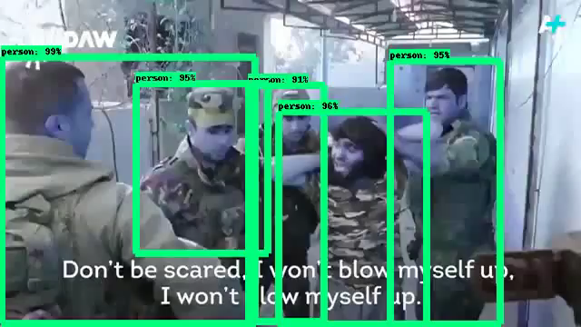

Slide 6

Embedded Speech Recognition
SesamePodcast.mp4
Transcript from video:
“Sesame Workshop is proud to bring you this Sesame Street podcast”
powered by:

